Slide 1

KUrOTTO
A RaRe BUT BRILLIANT PUZZLE

Slide 2
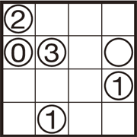
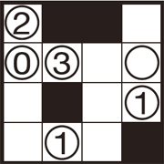
A BRIEF HISTORY
Kurotto is a relatively recent puzzle creation, first published in 2012 by Nikoli in quarterly Communication 138; the original author of the style was 活火山 (pronounced Katuskazan, a likely pseudonym meaning “Live Volcano”). It was inspired by other shading puzzles. The original name was “クロユニット” or Kuroyunitto (Kuro meaning “black” and “Yunitto” meaning the English homophone “unit”). The name was soon shortened to Kurotto, but there is a double meaning to this as Kurotto can also mean the English homophone “clot”.

Slide 3
RULES FOR KUROTTO
Fill in (color) cells with the following rules.
The number in a circle indicates the sum of the number of continuous black cells extending from it, vertically and horizontally. Empty circles may have any number of black cells around them.
Cells cannot be extended diagonally in any direction.
Cells with circles cannot be colored.

Slide 4
Aim of the project…
Created an AI solver to solve this intuition intensive puzzle for different sized grids
Generated and Solved the puzzle using BruteForce, Backtracking and Recursion Algorithms
Deterministic Strategies to optimise the code and come to the solution faster

Slide 5
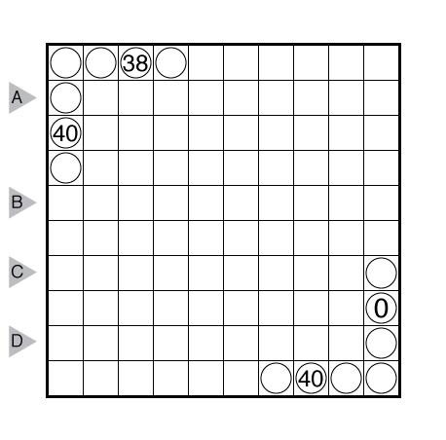
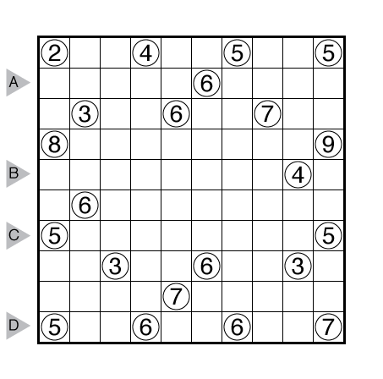
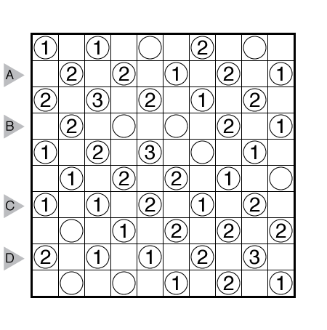
DIFFERENT KINDS OF KUROTTO PUZZLES

Slide 6
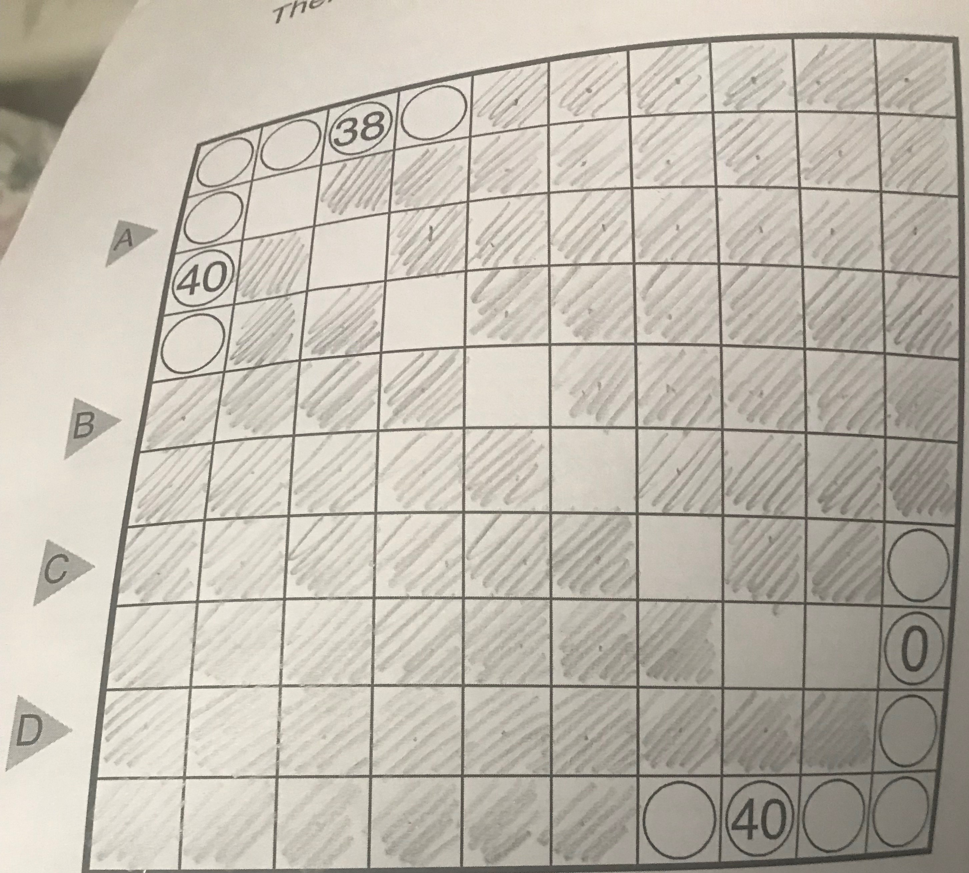
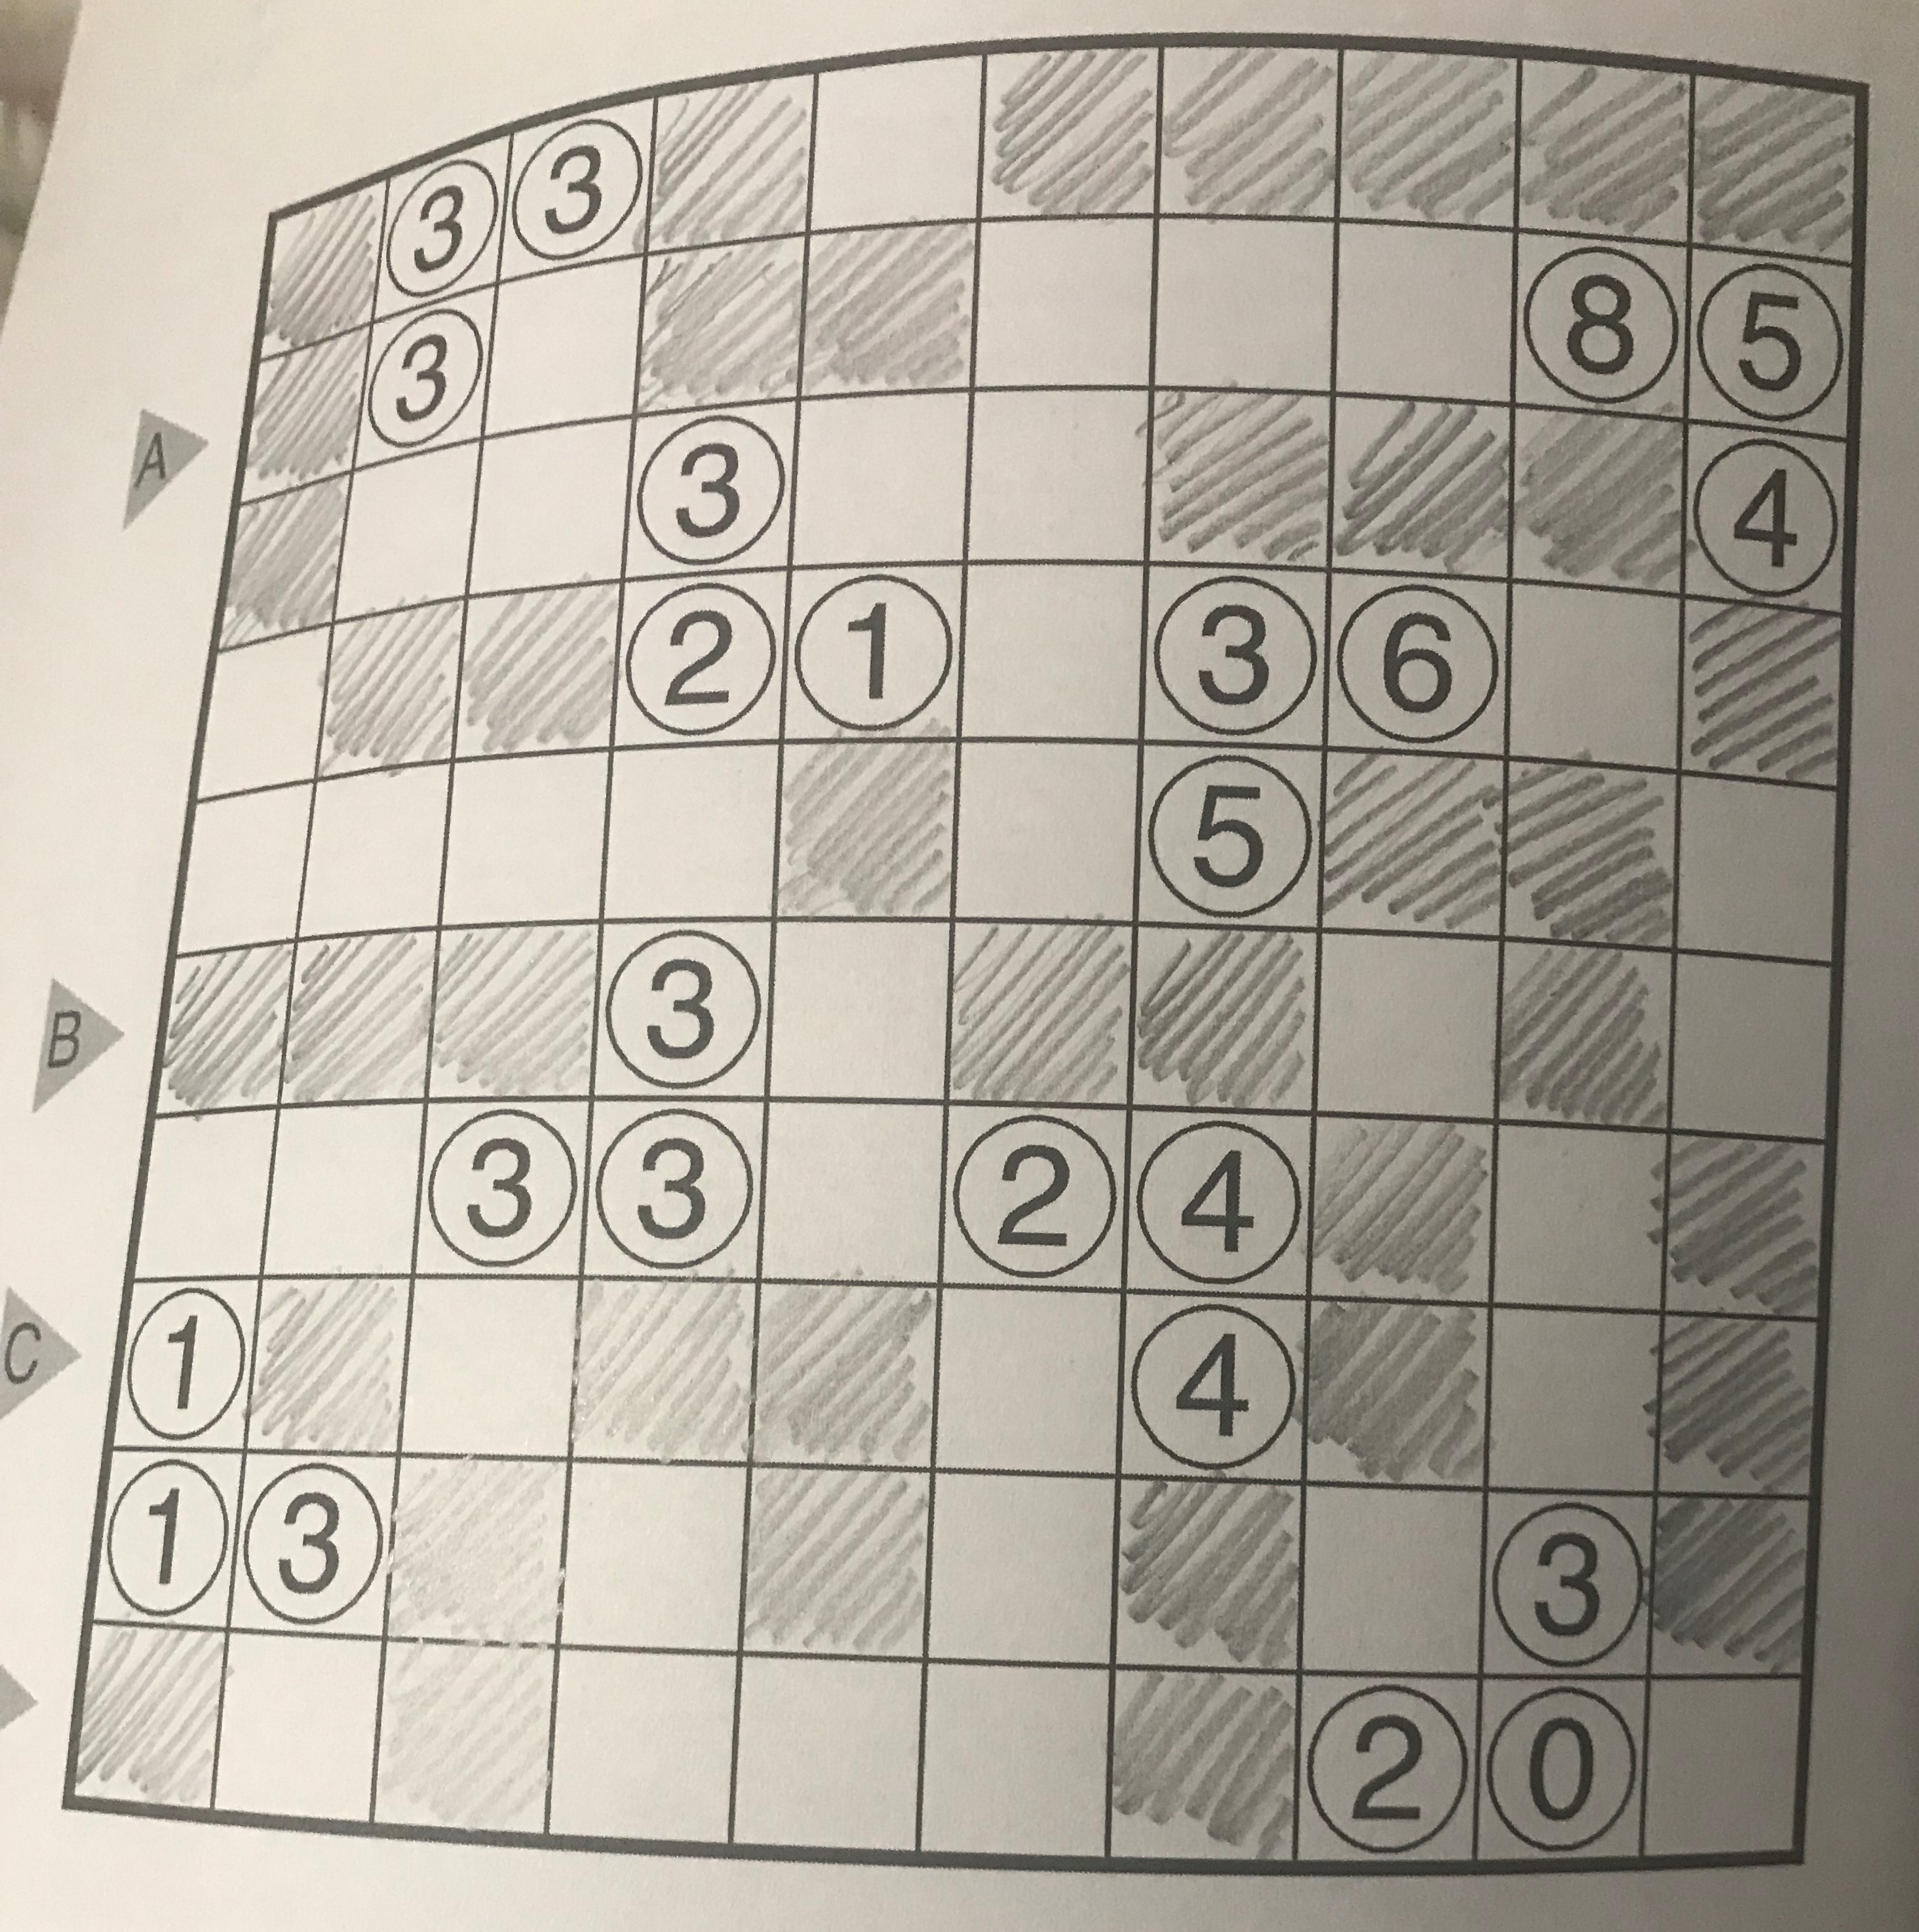
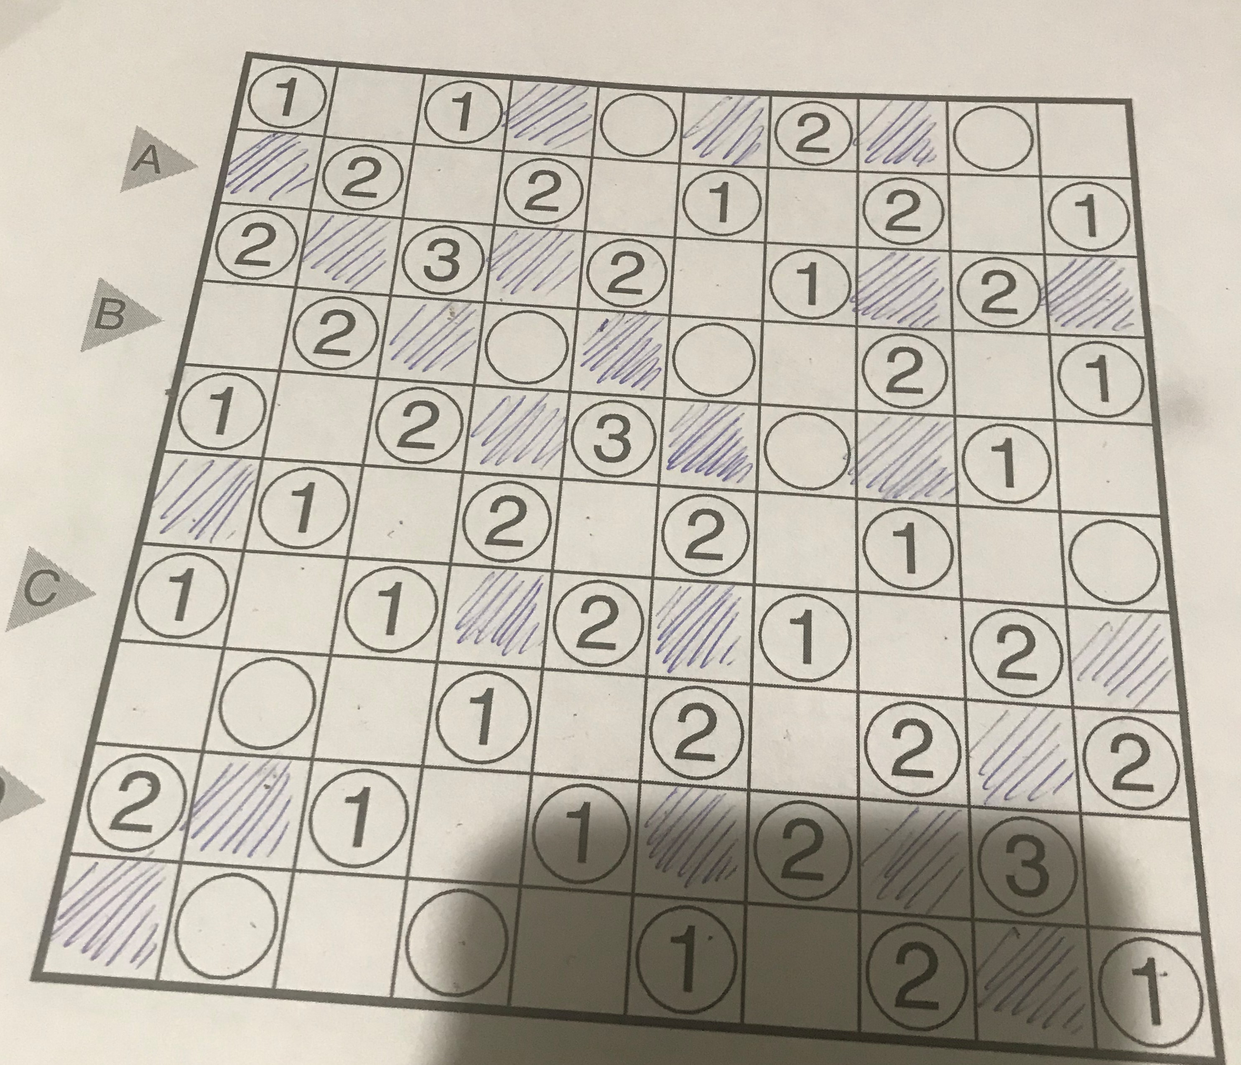
And some of their handsolved Solutions..

Slide 7
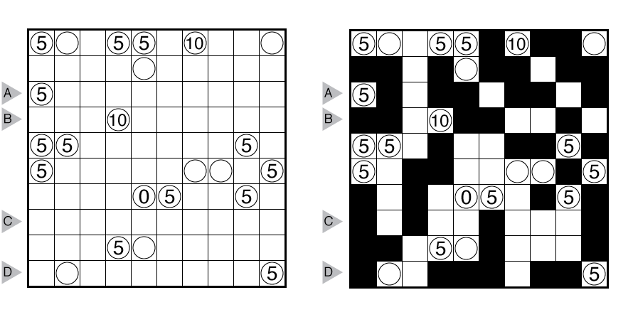
AI SOLVER FOR SOLVING KUROTTO WITH VARYING BOARD SIZES

Slide 8
A few Deterministic Strategies
Always start from a 0 if available to start filling in the cells
Start with the cells in the puzzle with the maximum difference in the values
Two number of the same or similar values are very likely to share shaded cells.
When total number of cells in the grid is less than the sum of the cells corresponding to numbers, many numbers would definitely share cells.
Since we have so many different approaches to solve this problem and not one approach is absolute I went for a brute force solver to solve these puzzles in general.

Slide 9
Functions created and My Brute Force Solving Approach
brute_force_generation (filled_cell, unfilled_cell, co_ordinate, board):
unfilled_cell_count (board, n):
count_for_numbers (board, n):
traversal (region, current, number, count, n, flag):

